Slide 1
Micro:bit Lunch & Learn

Slide 2
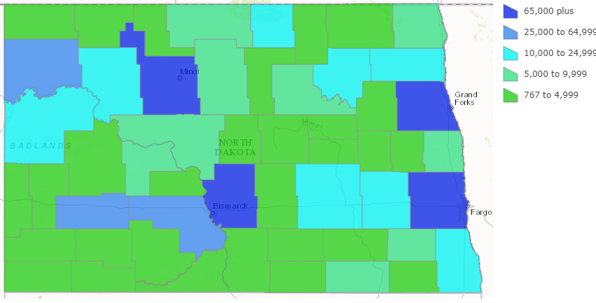
Problem
Software industry is facing a shortage of software engineers
High percentage of girls decide against STEM careers by the 5th grade
Many teachers are overwhelmed with teaching STEM
Limited STEM opportunities for students in rural areas
Notes:
(1) First stat was shared to me by a 5th grade teachers from Moorhead and Edgeley.
(2) There is no shortage of STEM learning materials, toys, etc. today – the issue is that teachers don’t have the time to learn which ones or best. And, they are unsure of how to keep kids advancing.
(3) The U.S .Census bureau defines rural areas to be population clusters with fewer than 2,500 hundred residents. In 2014, it was estimated that 37% of North Dakota's population lived in a rural area. This map depicts the breakdown of North Dakota's population by county, showing that the bulk of the state is composed of rural populations (shown in green). While strides are being made in metropolitan areas of North Dakota to provide STEM opportunities for children, there are still many children that are located far away from metro cities (notice that metro areas are shown in blue above). As a result, children in these rural areas are lacking access to STEM learning opportunities.

Slide 3
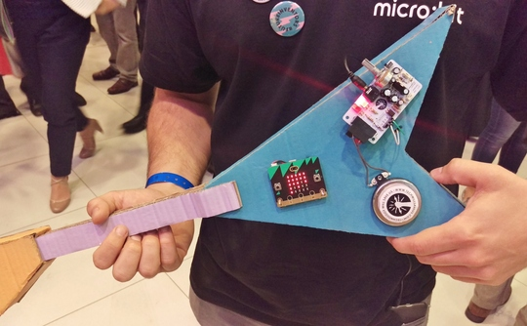
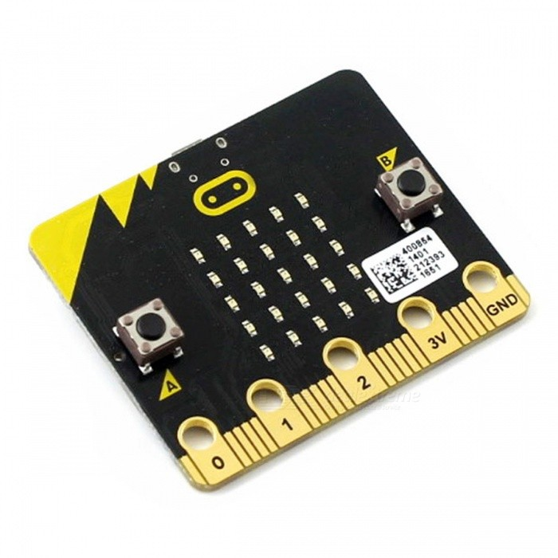
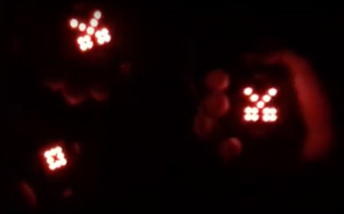
Solution: the micro:bit
A device you can use for all sorts of cool creations, from robots to musical instruments – the possibilities are endless.
Excellent platform to teach with
Cost effective
$16.50 includes micro:bit, usb cable & battery pack
Appealing to a wide age range
Inclusive to a variety of backgrounds
Works with a variety of devices

Slide 4
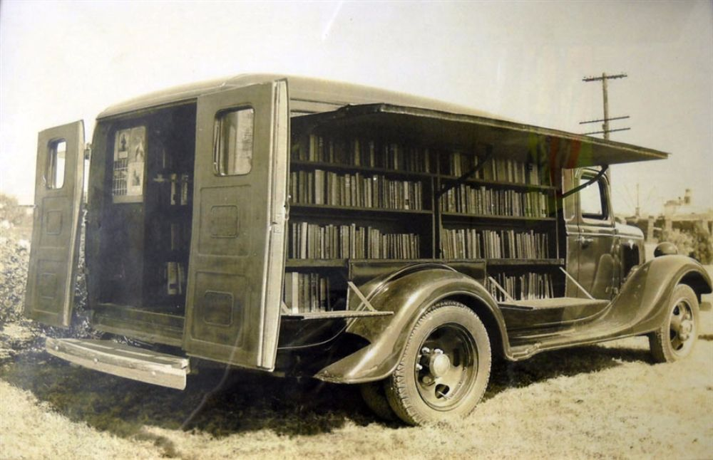
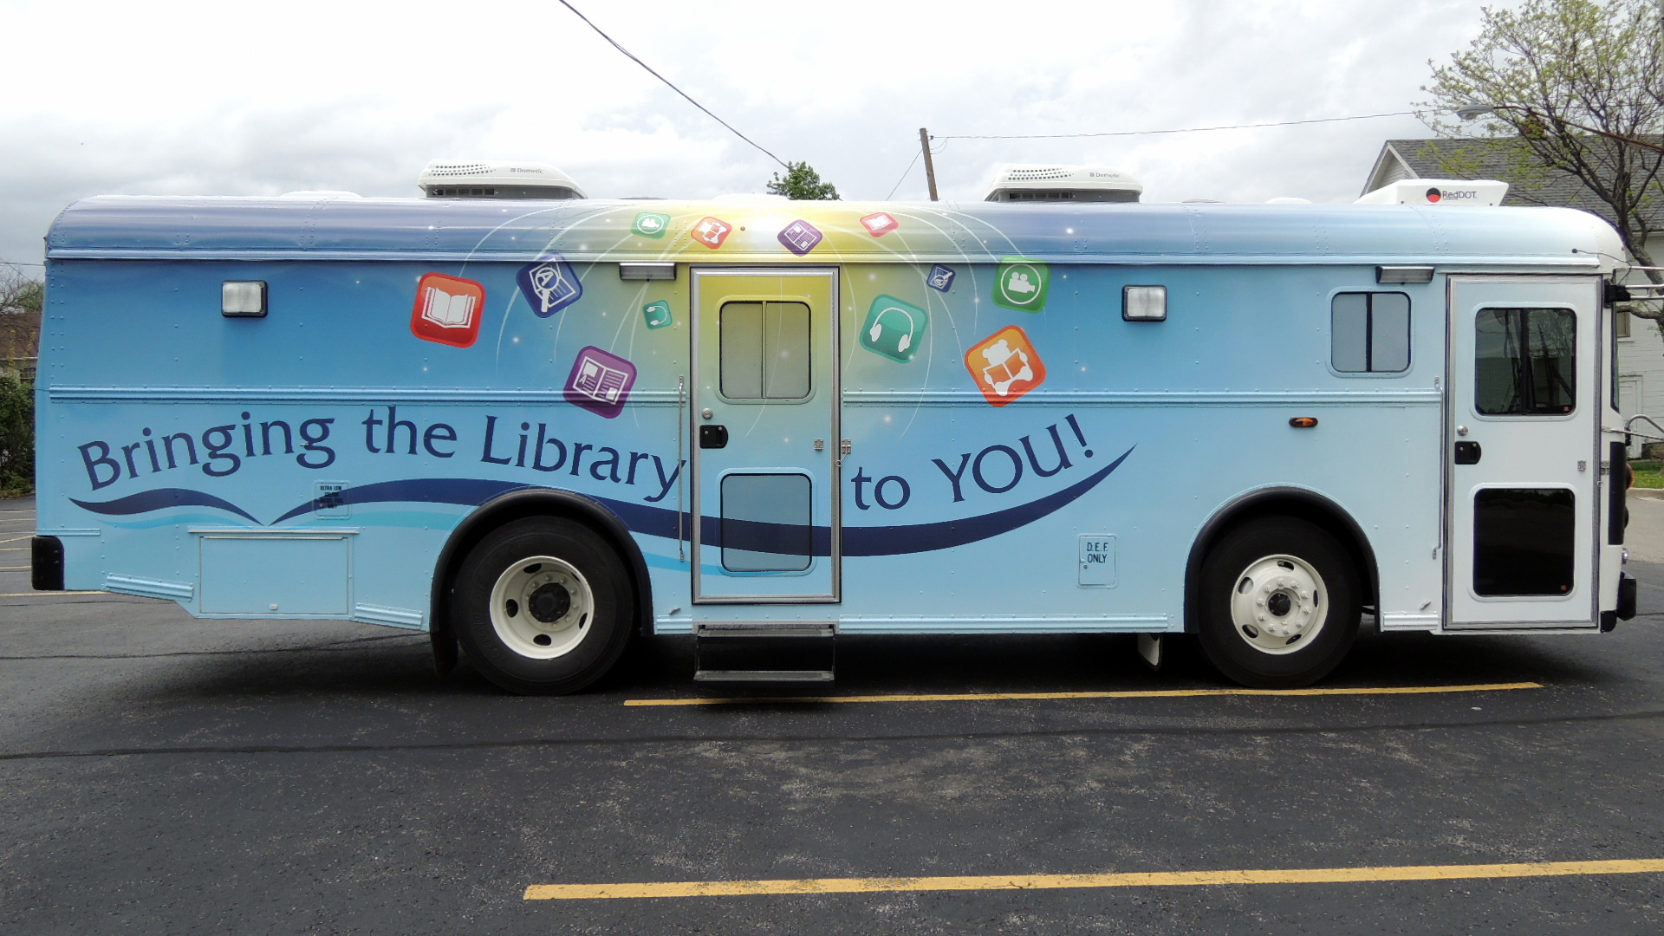
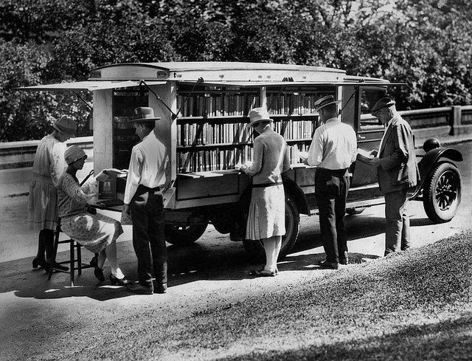
TechMobile Initiative
Travel to rural areas
One engagement per month
Starting to encounter volunteer bandwidth limitations
Provide students with learning resources
Give the students micro:bits to continue exploration
Notes:
The micro:bit was designed to be classroom-friendly from day one. More approachable than just coding, it's a great way to achieve fun, practical results with motivated students.

Slide 5
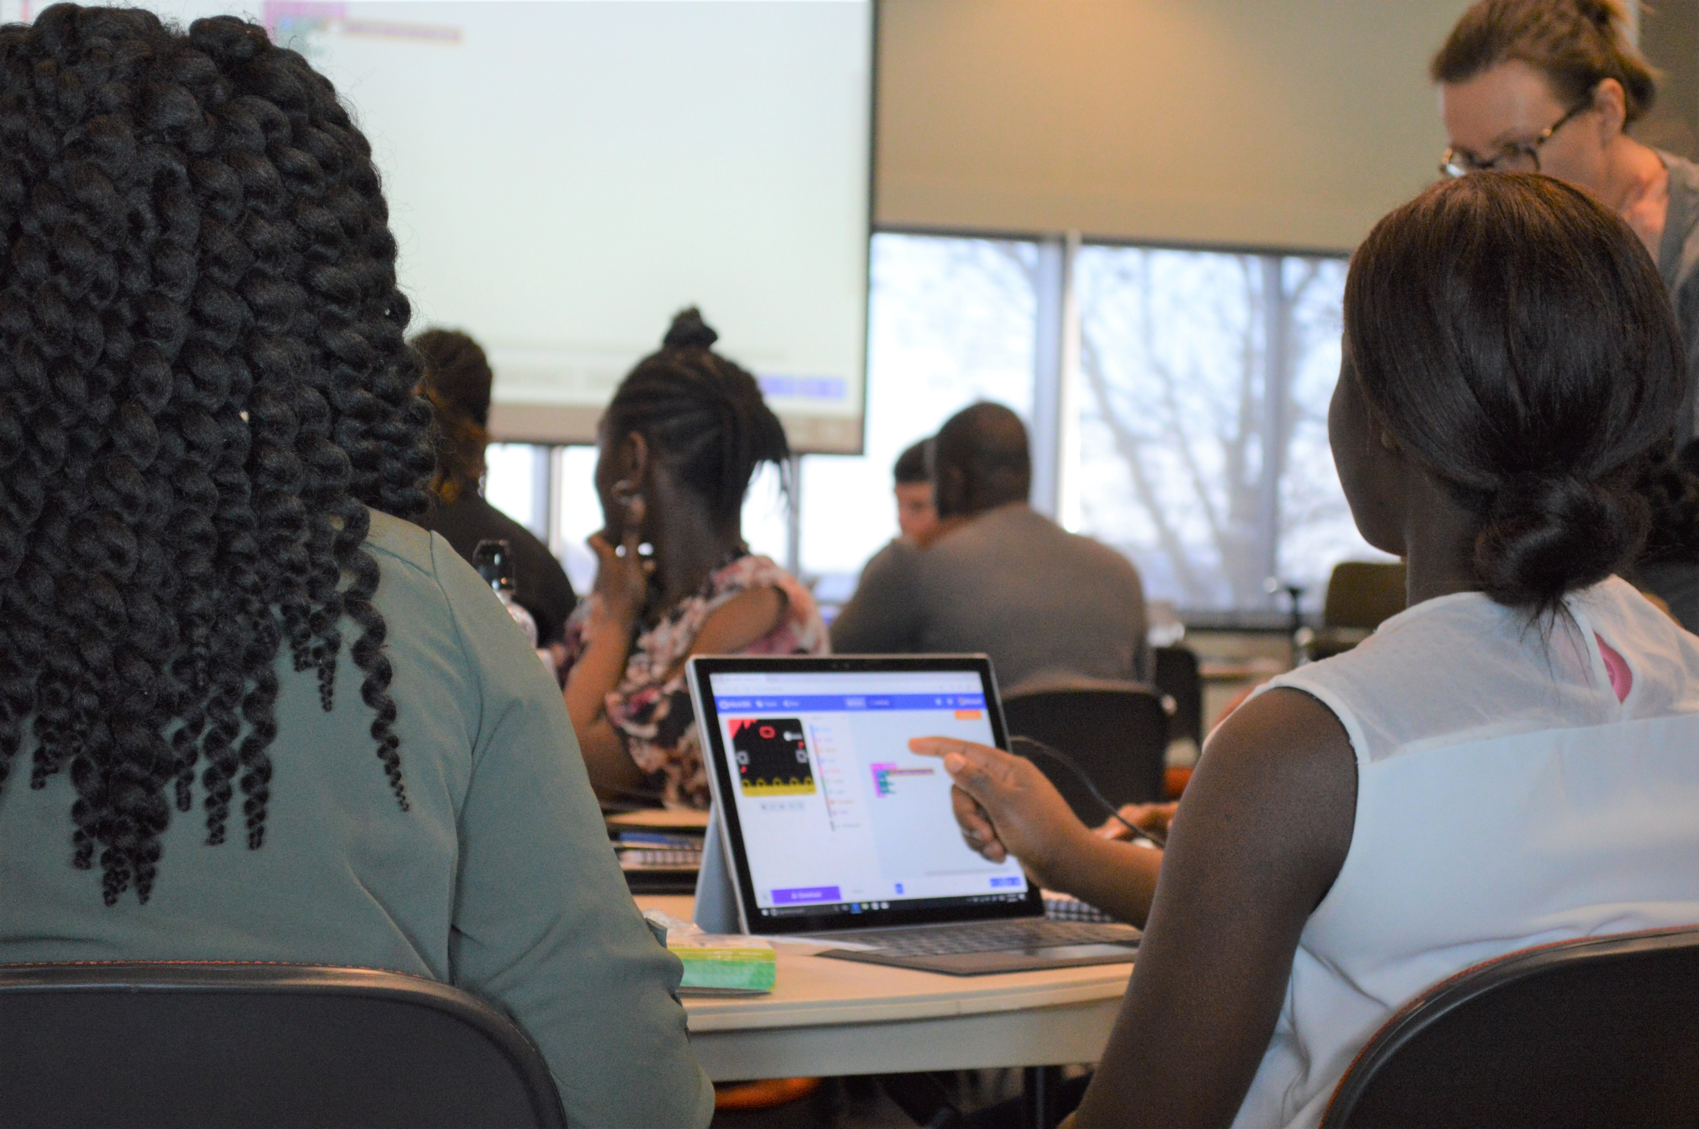
Research Findings (BBC)
90% of students said the micro:bit showed them that anyone can code.
86% of students said the micro:bit made Computer Science more interesting.
70% more girls said they would choose Computing as a school subject after using the micro:bit.
85% of teachers agree is has made Computer Science more enjoyable for their students.
Half of teachers are more confident in teaching Computing after using the micro:bit.
Notes:
For last one – mention that this is in particular, those teachers that didn’t previously feel confident in teaching Computing.

Slide 6
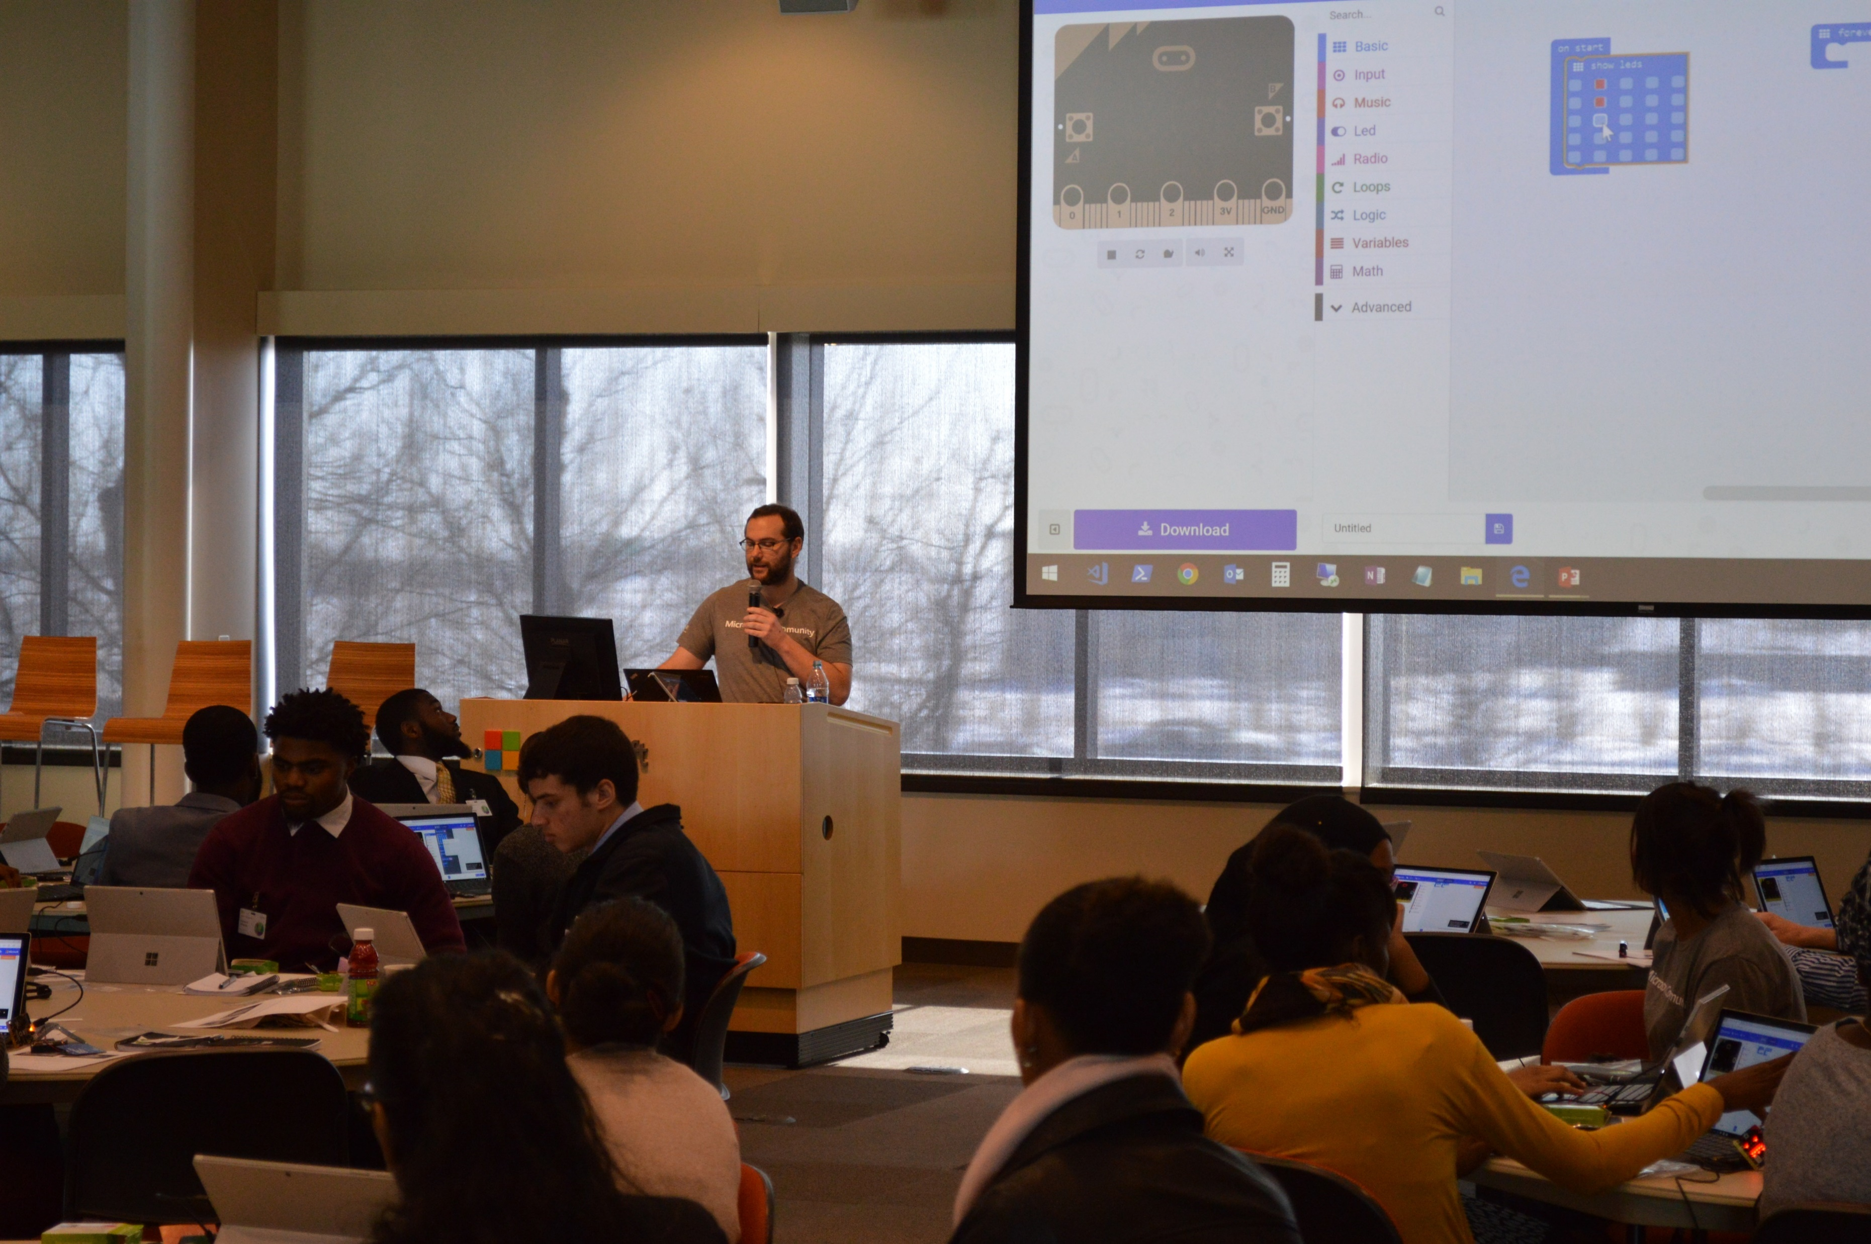
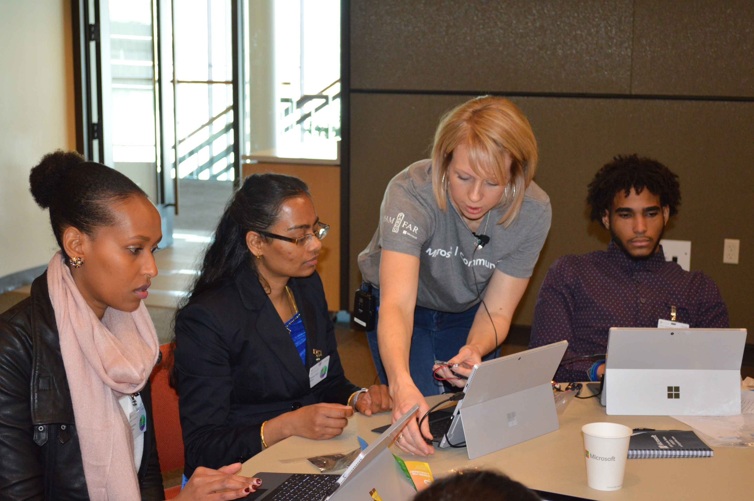
micro:bit History
Designed to encourage children to:
Get actively involved in writing code
Build new things
Distributed to all 7th graders in Britain
* Around 1 million devices
Created by BBC and partners
* Microsoft, Lancaster University, Nordic Semiconductor, Farnell Element14, Samsung, etc.
Micro:bit Educational Foundation is a non-profit setup to handle the future

Slide 7
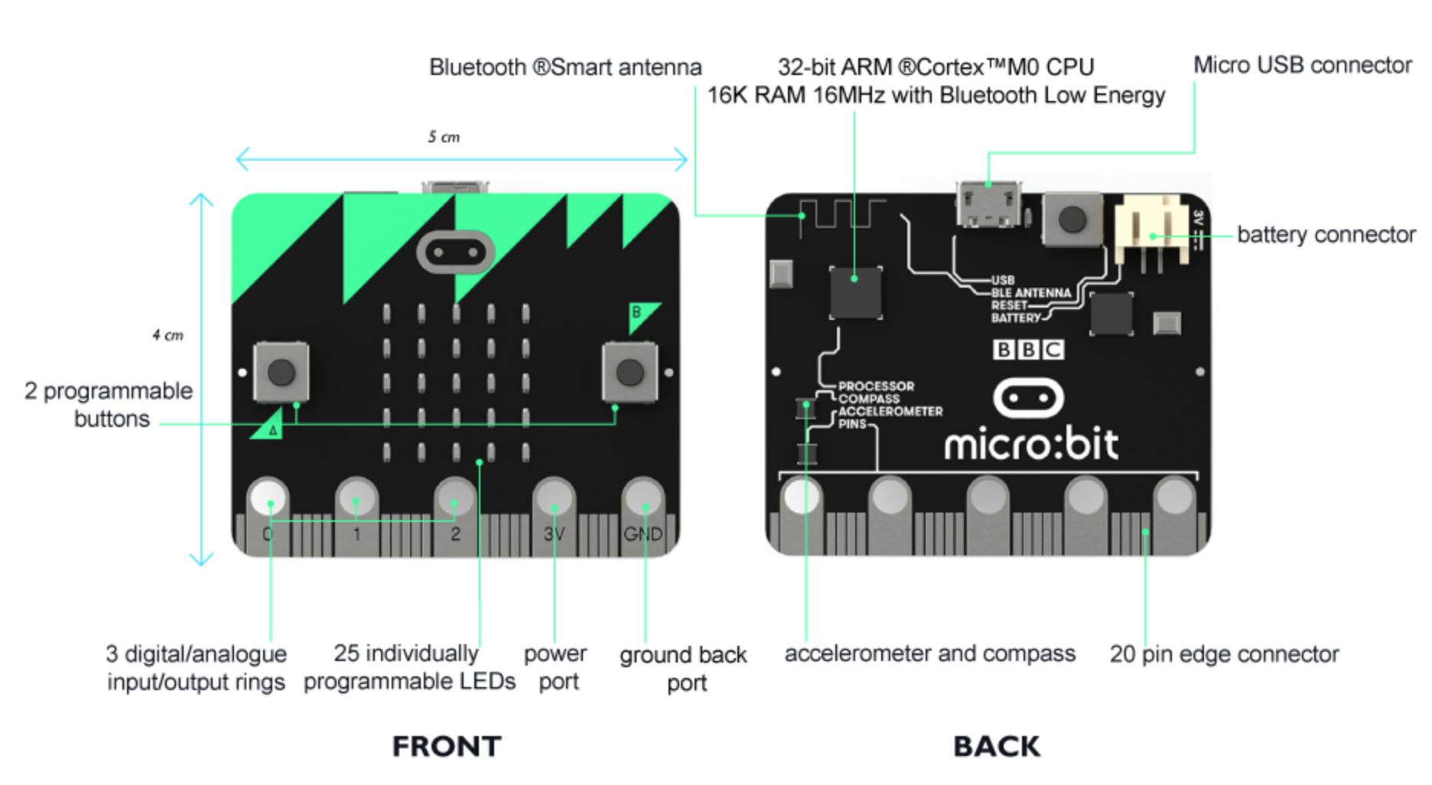
Physical Features
Notes:
Describe physical features:
25 individually-programmable LEDs
2 programmable buttons
25 physical connection pins
Light and temperature sensors
Motions sensors (accelerometer and compass)
Wireless communication, via radio and Bluetooth
USB interface

Slide 8
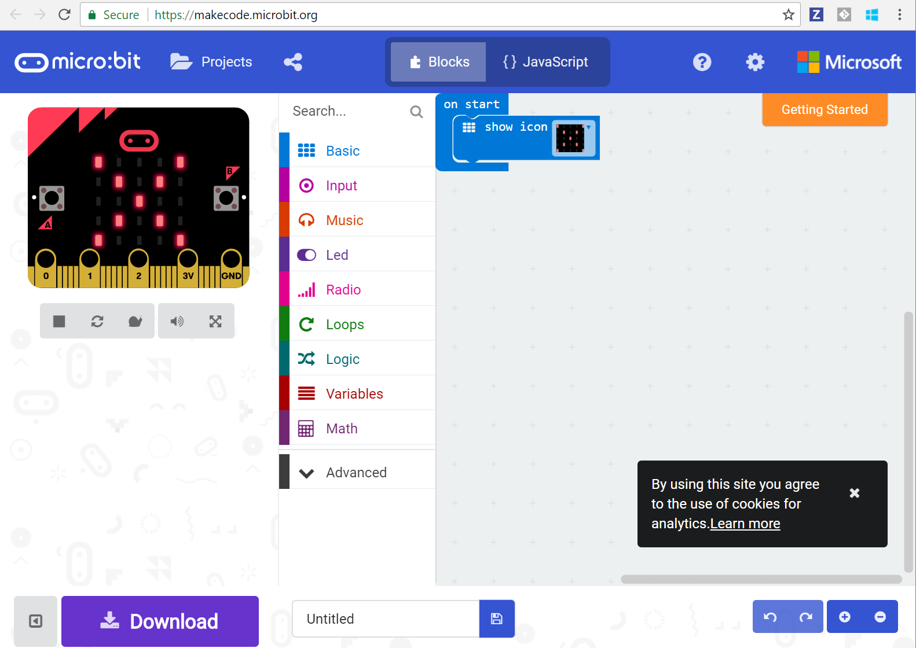
Coding Experience
Notes:
Block Editor (https://makecode.microbit.org/#)
Drag and drop experience
Built in emulator
Download program to run on your own micro:bit
JavaScript and Python experiences for more advanced students

Slide 9
Demo

Slide 10
Projects
Rock Paper Scissors
With Teams
Watch
Compass
Coin Flipper
Hot or Cold
Reaction Time
Voting Machine
Infection
Guitar

Slide 11
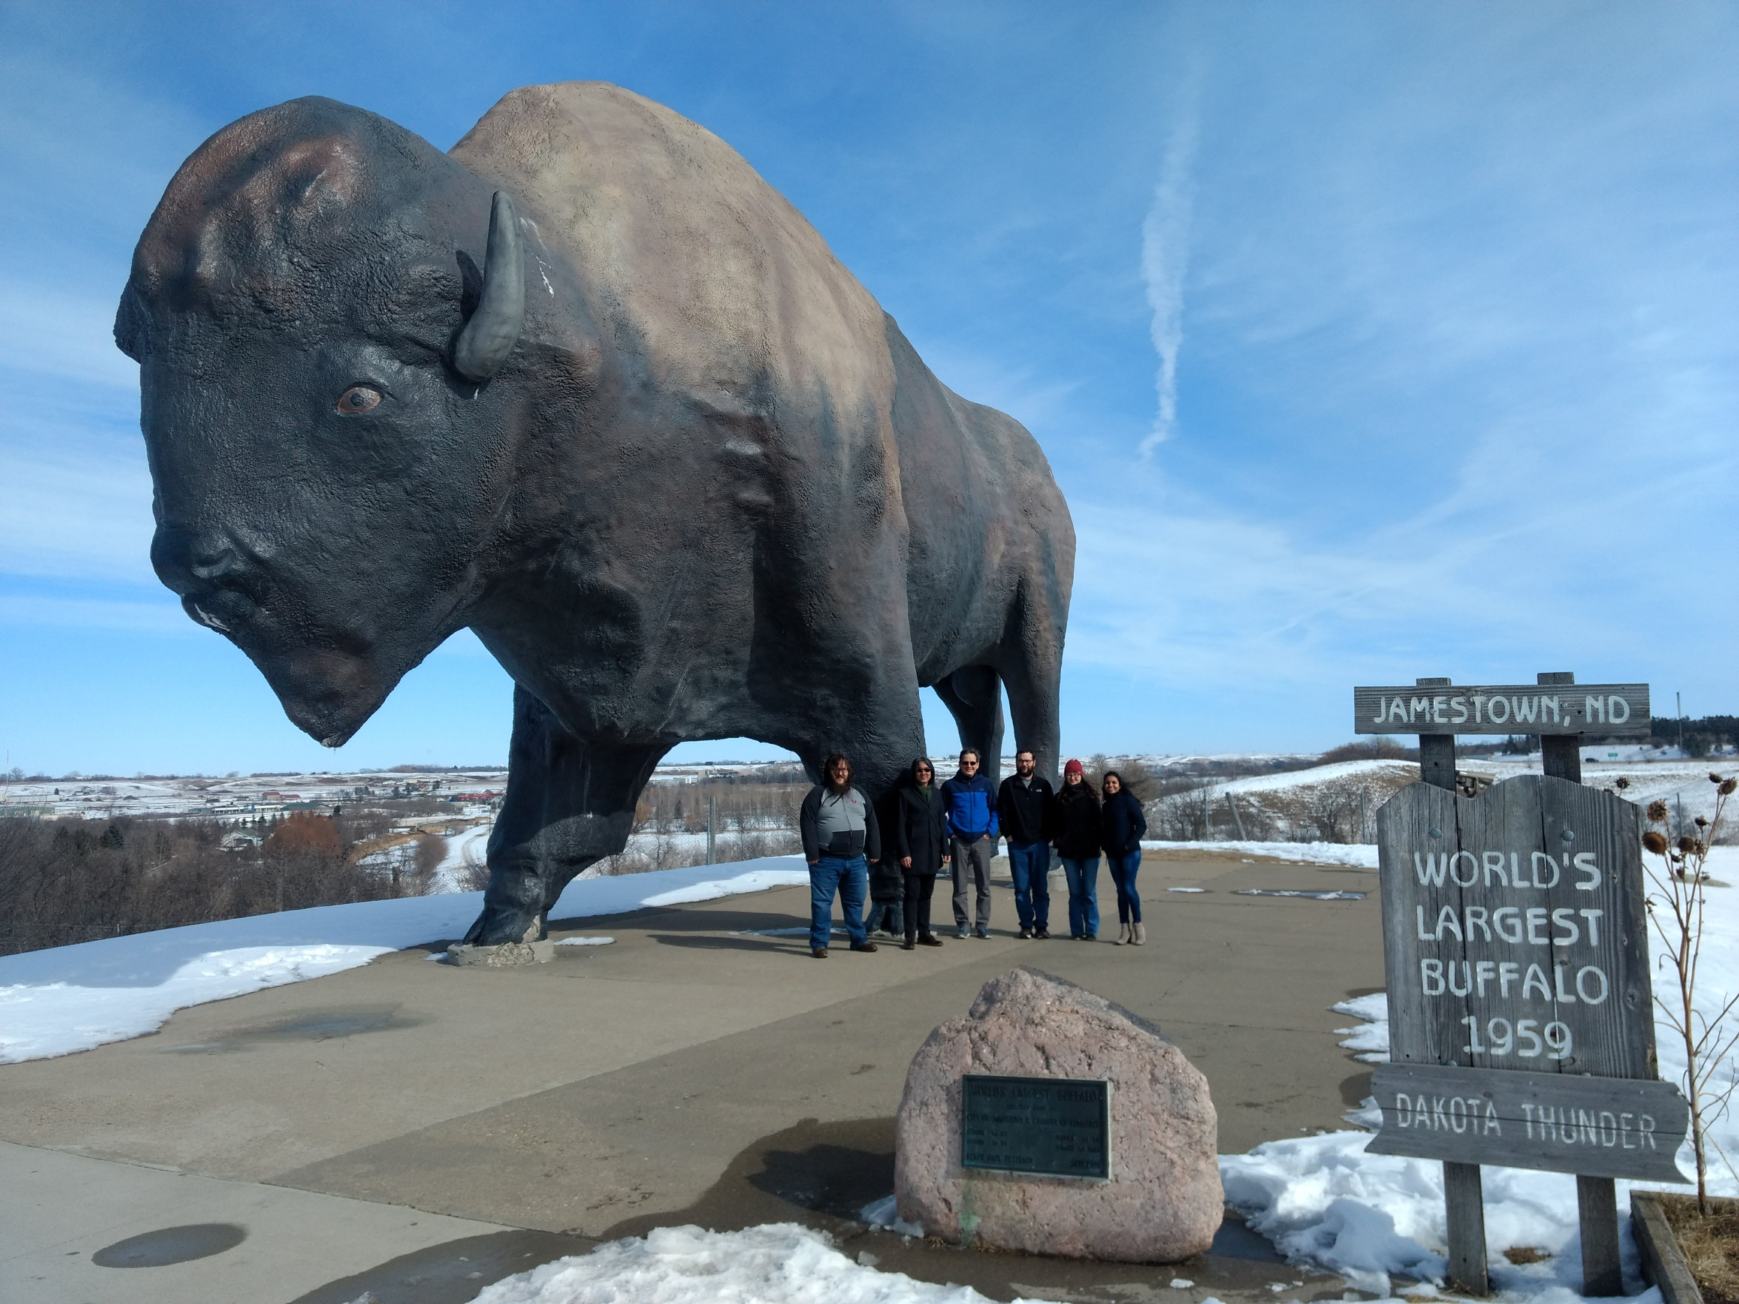
Engagements:
BAM (High School & College)
STEMtastic/TechSavvy (7th & 8th Grade)
Ed Clapp (4th Grade)
Edgeley (5\6th Grade)
Notes:
BAM – pilot – older age group
Jamestown – segregated by gender – such a different learning behavior
Ed Clapp - wanting to adopt curriculum (coming back and plans for next year)
Edgeley – school that triggered it all. Had all these STEM activities already but didn’t know how to get to the next level.

Slide 12
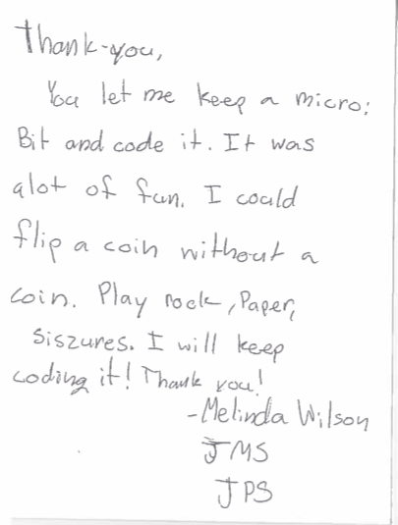
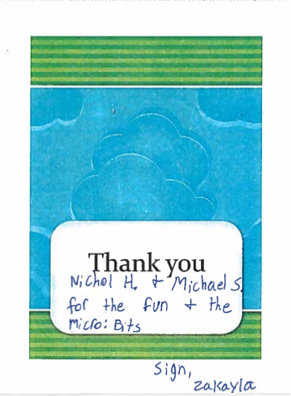
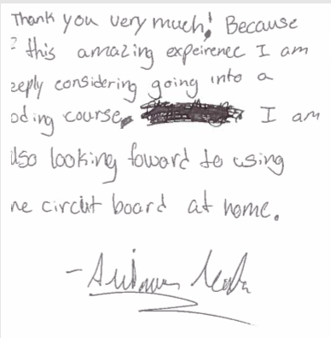
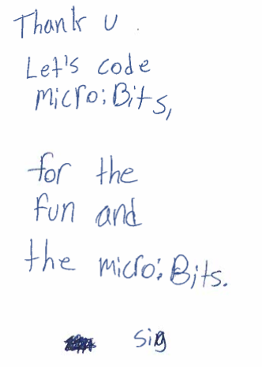
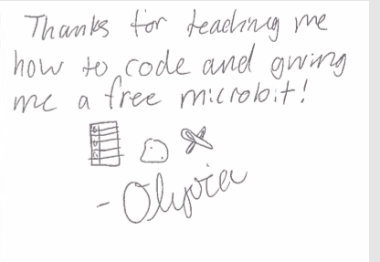
STEMtastic\TechSavvy Experience
Notes:
Mention that students were divided into boys\girls – studies have shown that girls ask more questions and have better participation when boys aren’t present.

Slide 13
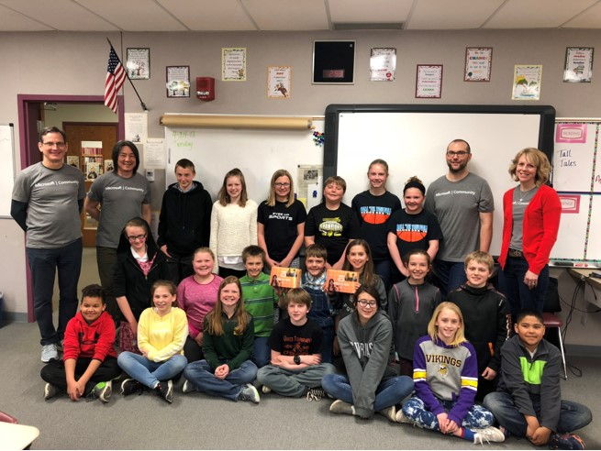
Edgeley Experience
5th/6th grade, including students from Hutterite colony

Slide 14
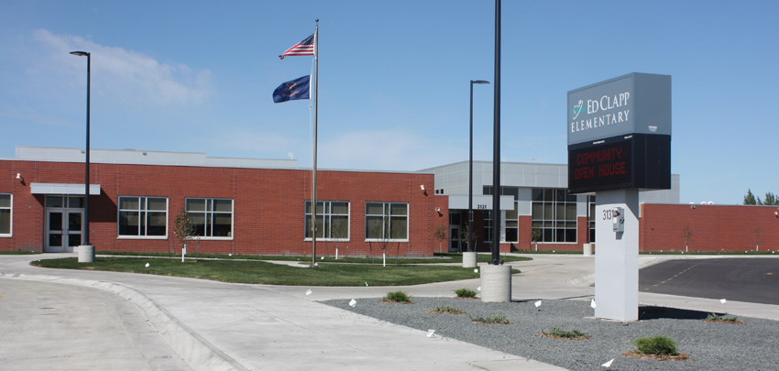
Ed Clapp Experience
Inclusive learning for all:
Non-native speakers
Limited mobility
Autism

Slide 15
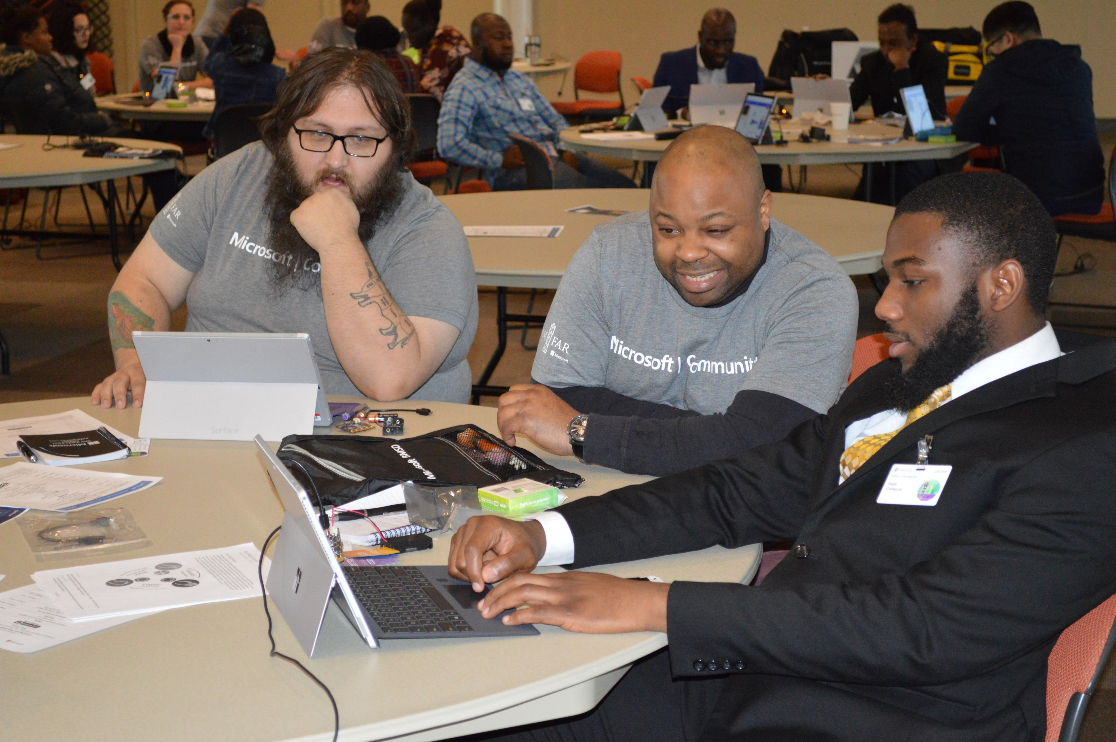
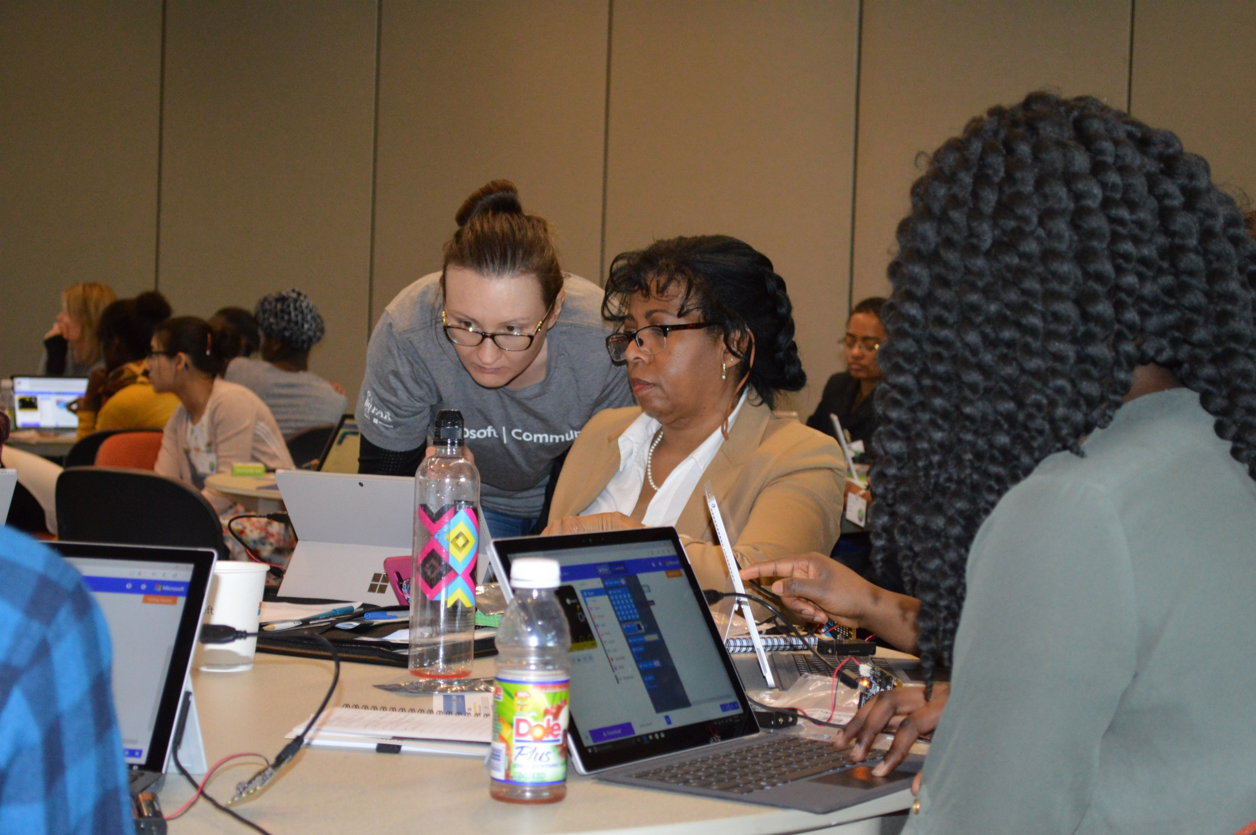
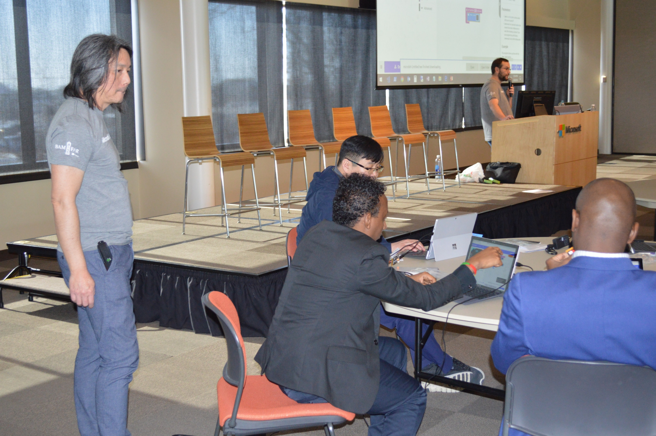
Additional Experiences
Always get questions on where to get
Cheers when they find out they get to keeps
Excited about Microsoft coming to town
Numerous occasions of students not want to stop the exercise

Slide 16
How you can help
Volunteer by
Emailing msimons@Microsoft.com or nicolela@Microsoft.com
Joining DL: techmobile@Microsoft.com
Support us by sharing contacts of interested schools/organizations
Upcoming events
DigiGirlz
Train the Trainer Brownbag (June 4th ?)

